Slide 1
Video Game
Data science
Presented by: Hen tzalah & Liz logasi
Notes:
Illustration: Freepik

Slide 2






Crawling
EDA
Conclusions
Timeline
Presenting the prediction question
Cleaning the data
ML
Notes:
Illustration: Freepik

Slide 3
Presenting the prediction question
Notes:
Illustration: Freepik

Slide 4

The prediction question
It was important for us to choose a theme project that interested us so we chose video games.
We thought what can we predict in video games? What we can take from the sites on the internet and from which site? Because it’s known that there are a lot of sites that deal with games, but from which site we can get the relevant information?
Can we predict the success of a particular game in different areas according to its sales ratio?

Slide 5
Crawling
Notes:
Illustration: Freepik

Slide 6

Data source
https://www.vgchartz.com
It took several days to run the scraping code because:
The site was very slow
We got 503 status codes
Finally we have got 62,182 games in our dataframe

Slide 7
Data scraped
Video game name
Developer
Platform
Genre
Japan sales
Europe sales
USA sales (NA-North America)
Other sales
Total sales
Release date

Slide 8
How we did it ?
We used python scraping libraries (requests & bs4).
We used requests to send a requests to the webpage תכניסי פה את האתר , the page contains 200 records per genre.
We used a list of genres to iterate over the pages, which allowed us to scrape all of the data in one long run.
We scraped all of the data for each genre, when we got to the last page, it did load, but it showed no content, and that was the trigger for moving to the next genre.
The page was pretty easy to scrape due the fact that most of the data was in one line, and we just had to select the items we want by the index.
After we finished scraping, the data was saved in a json, which then was transferred to a CSV file for further work on the data.
We nocied that we don’t get 403 or 401 status codes, which means that we did not get blocked, so we used time.sleep(n) function when we got 503 status code, or 503 in the page content, that allowed us to run the request is a recursive way and retry attempts untill we did establish a connection to the webpage.

Slide 9
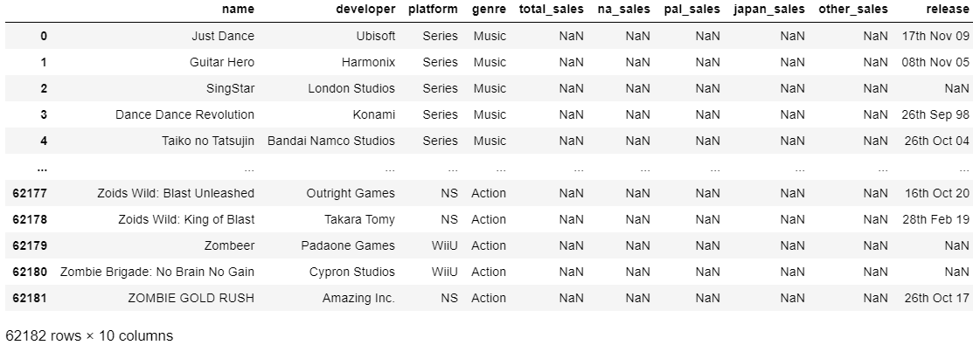
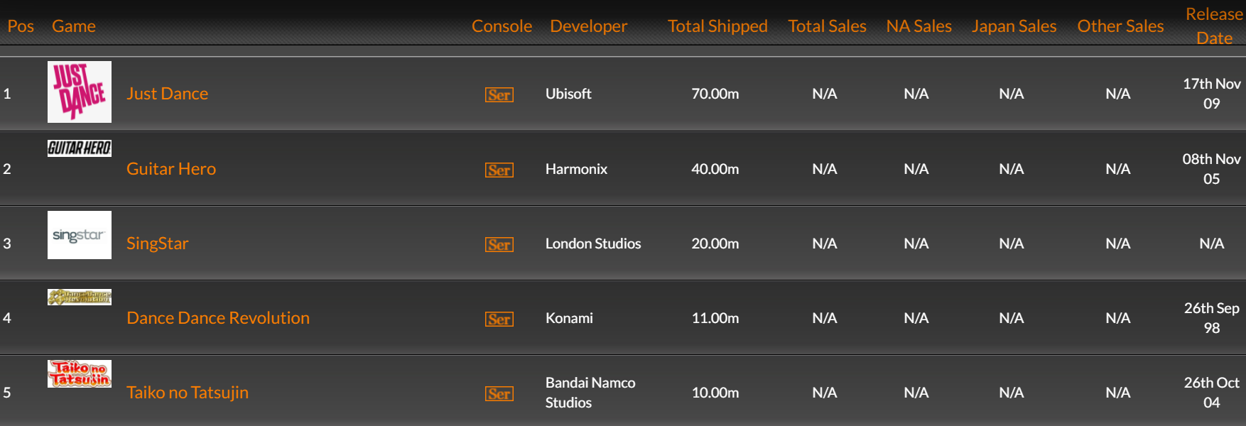
Before & After

Slide 10
Cleaning the data
Notes:
Illustration: Freepik

Slide 11
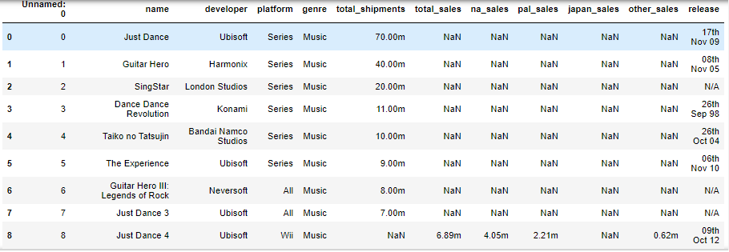

Cleaning the data
We got a large amount of data (62182 rows × 12 columns) but we got some problems:
We go N/A instead of NaN in the “release” column
The date format in the “release” column and we want only the release year
A lot of NaN value into our data
The letter ‘m’ in our sales columns
For the same game name there can be different platform, but if the name and the platform are the same it counts as a duplicate row

Slide 12
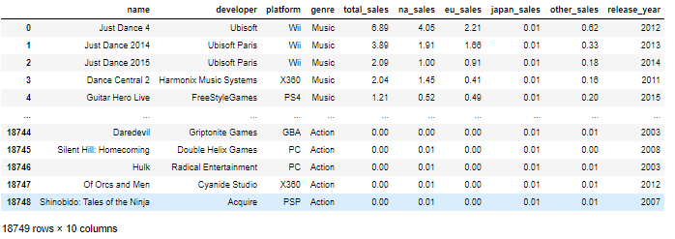
Cleaning the data
Our clean data: (games_df.csv)

Slide 13
EDA
Notes:
Illustration: Freepik

Slide 14

75%
50%
0%
100%
Exploratory Data
Analysis
In this part we will show you our graphs and our conclusions from them.

Slide 15
About The Dataset
name: Name of the game.
developer: The company that design the game
platform: Name of the game machine. For example, PS2, Xbox, and so on.
genre: The genre of the game. For example “Just Dance” – Music.
total_sales: The Video Games Sales for all markets.
na_Sales: The Video Games Sales in North American.
eu_Sales: The Video Games Sales in Europe.
jp_Sales: The Video Games Sales in Japan.
other_Sales: The Video Games Sales in the rest of areas.
release_year: It is a number describing when did the game release.

Slide 16
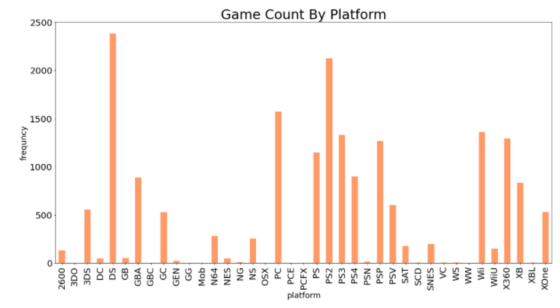
Exploratory Data Analysis
Univariate Analysis:
Our plot above gives us an idea of how many games per console our data contains but we immediately noticed that our platforms include handhelds, consoles, and the PC. so we group these and see what our distribution looks like.
Notes:
Nintendo DS – handheld
Japan

Slide 17
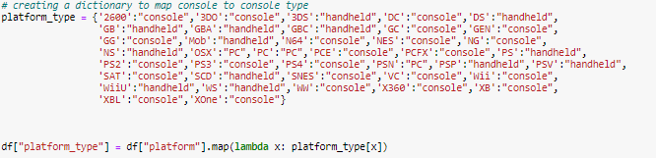
Exploratory Data Analysis
PC
Console
Handheld

Slide 18
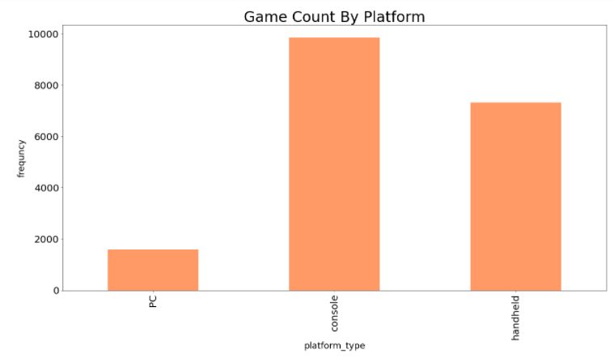
Exploratory Data Analysis
We can see that there are about ~9,500 more console games than PC releases in our data.
we will see later how these compare in sales figures.

Slide 19
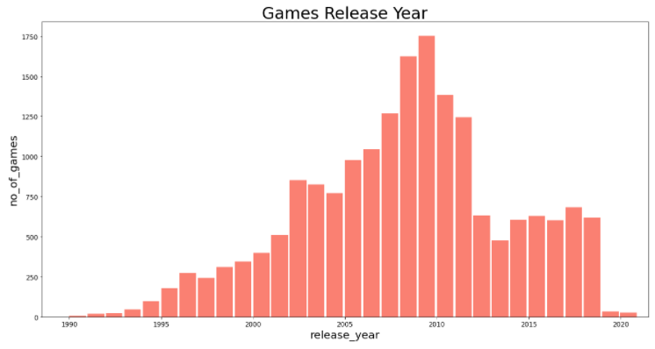
Exploratory Data Analysis
It looks like our data has left skew, indicating that there are more game releases in recent history ~(2005 - 2010)

Slide 20
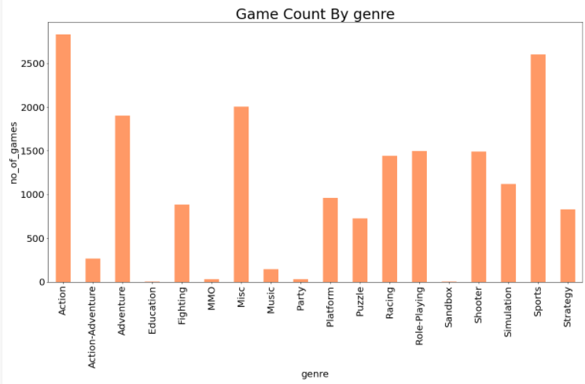
Exploratory Data Analysis
It looks like Action games appear the most. But we are not sure who or how a genre is decided. Would a game like "Adventure Time: Explore the Dungeon Because I Don't Know!" be "Action", "Adventure", or "Action-Adventure"?
(fyi - most Adventure Time games are labeled as Action with some marked as Adventure)

Slide 21
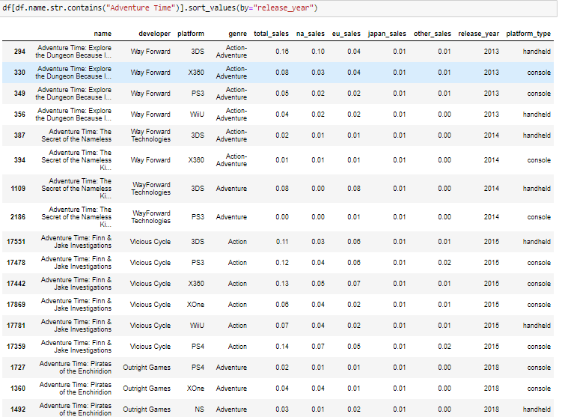
Exploratory Data Analysis

Slide 22
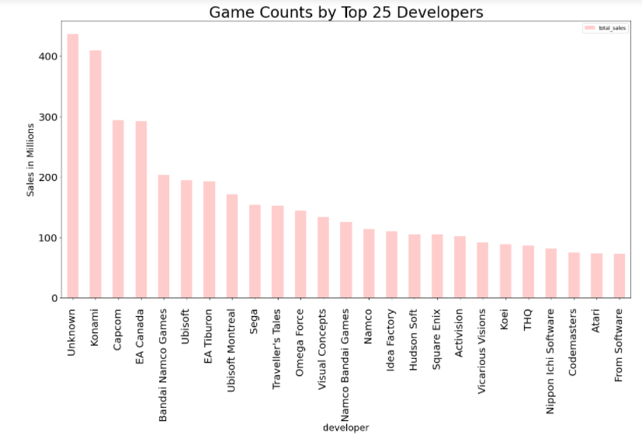
Exploratory Data Analysis
We have a large "Unknown" developers in our data, but we guess it is no surprise that "Konami" has the most game releases; without looking at our data we are guessing this is due to the sports games it releases for all consoles each year...

Slide 23
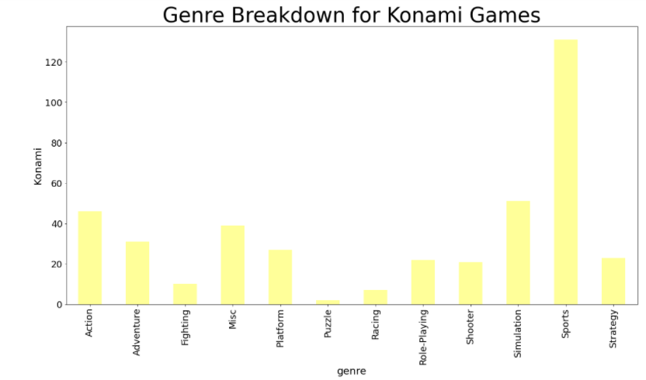

Exploratory Data Analysis
We are not surprised ☺

Slide 24
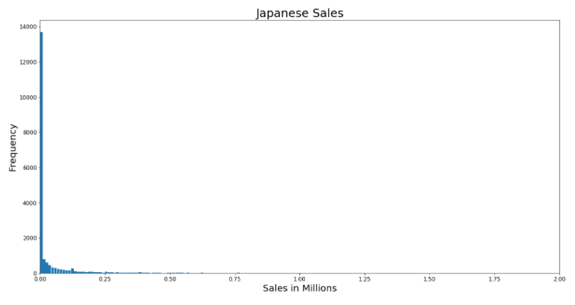
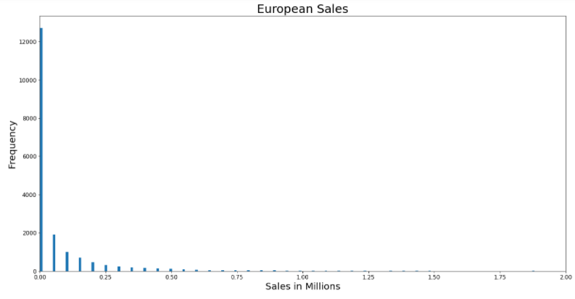
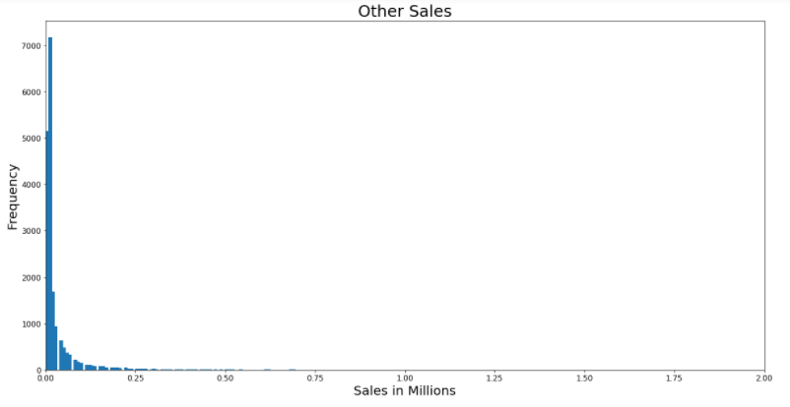
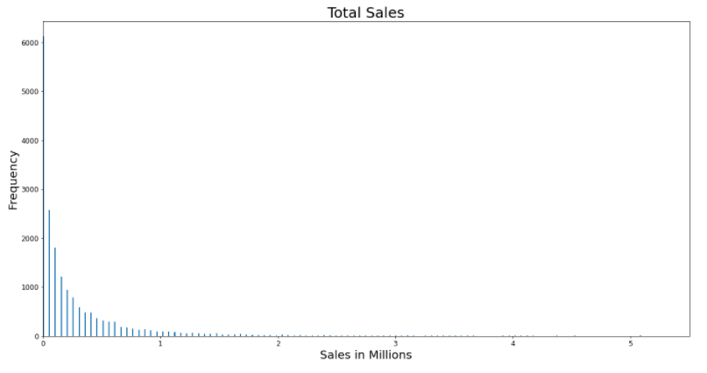
Exploratory Data Analysis
In japan sales we had the most NaN value of sales..

Slide 25
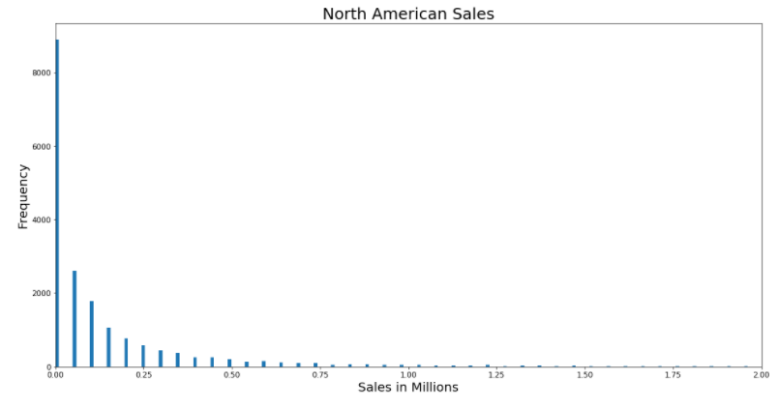
Exploratory Data Analysis
And the winner is…

Slide 26
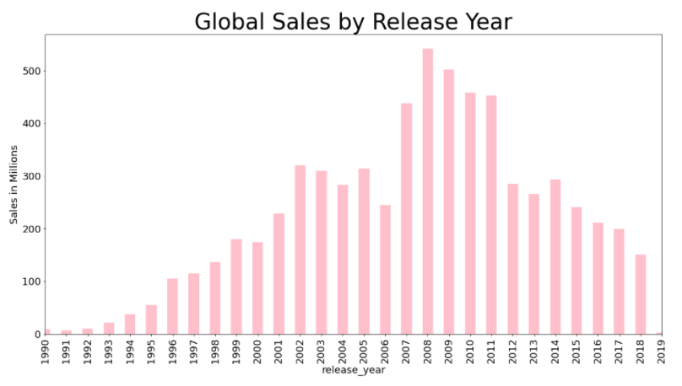
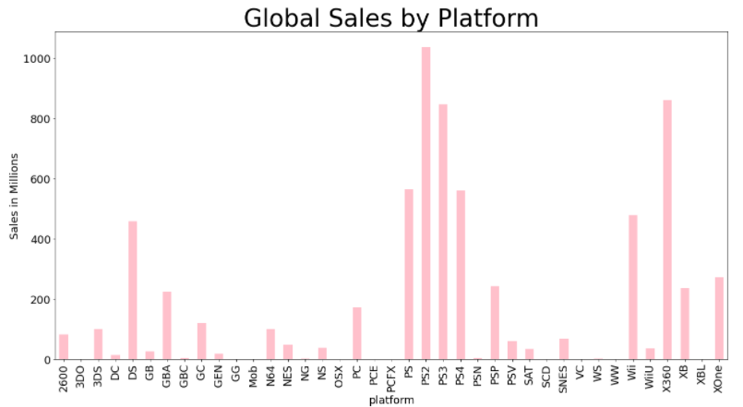
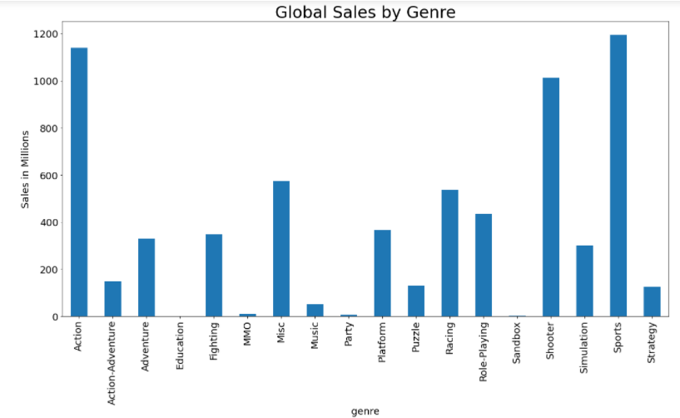
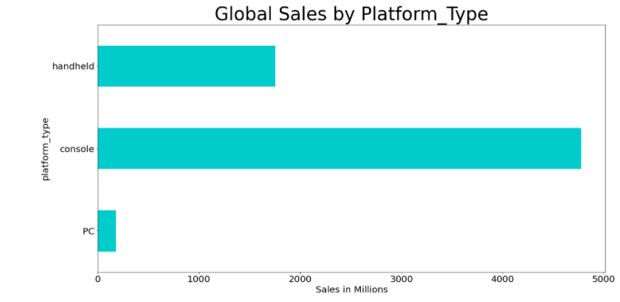
Exploratory Data Analysis
Bivariate Analysis:
Best-selling year - 2018
Best-selling platform - PS2
Best-selling genre - sport
Best-selling platform_type - console

Slide 27
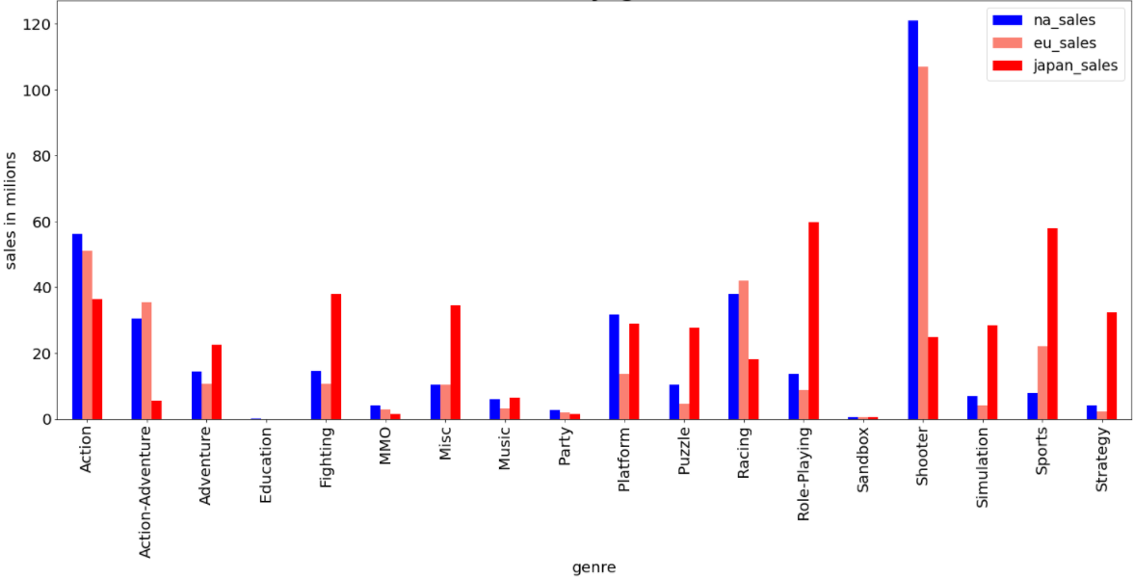
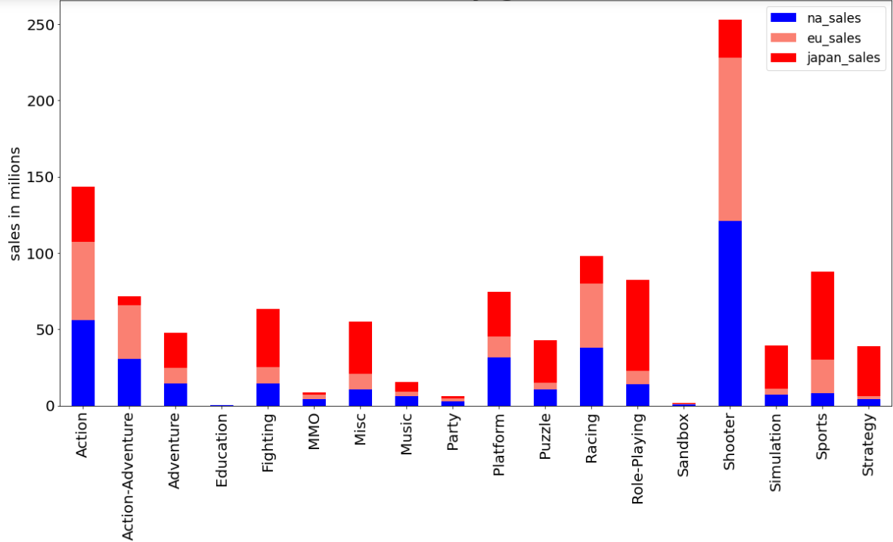
Exploratory Data Analysis
Multivariate Analysis :
The connection between the genre and its success in a particular area according to its sales.
We took the 100 best-selling games in each genre, and examined their sales in each region
Racing and action-adventure games are more successful in Europe
Shooting, platform, party, MMO and action games are more successful in the USA
Role-playing, sports, fighting, strategy, note, music, puzzle and simulation games are more successful in Japan

Slide 28
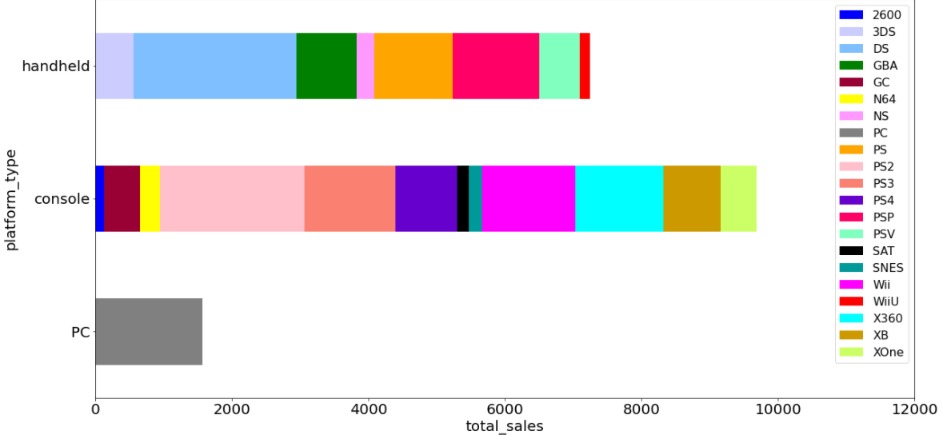
Platforms
The relationship between the type of platform and its popularity given its sales
A console-type platform is more successful than others

Slide 29
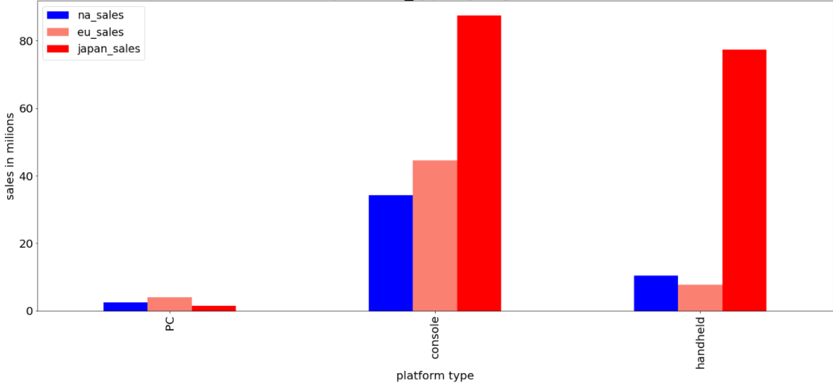
Platforms
We took the 100 most successful games from any platform type and examined the relationship between the type of platform and its success in each region.

Slide 30
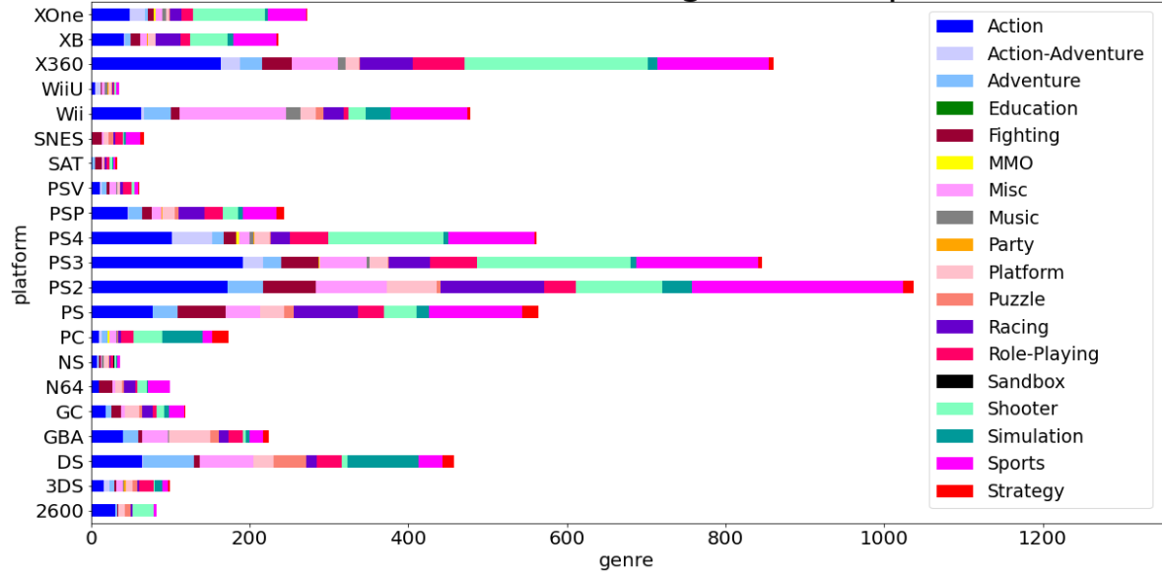
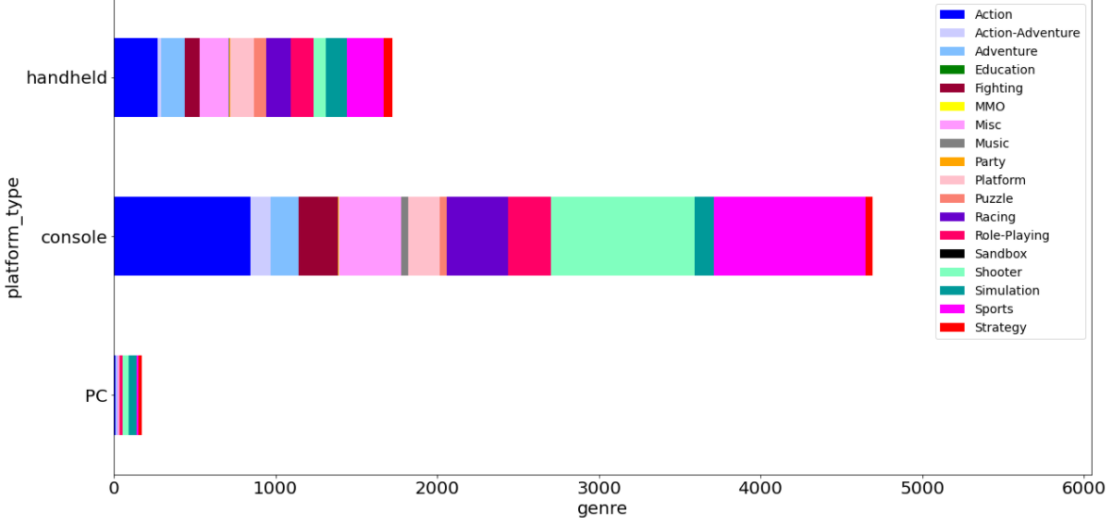
Platforms & Genre
We will examine the relationship between the platform and the genre

Slide 31
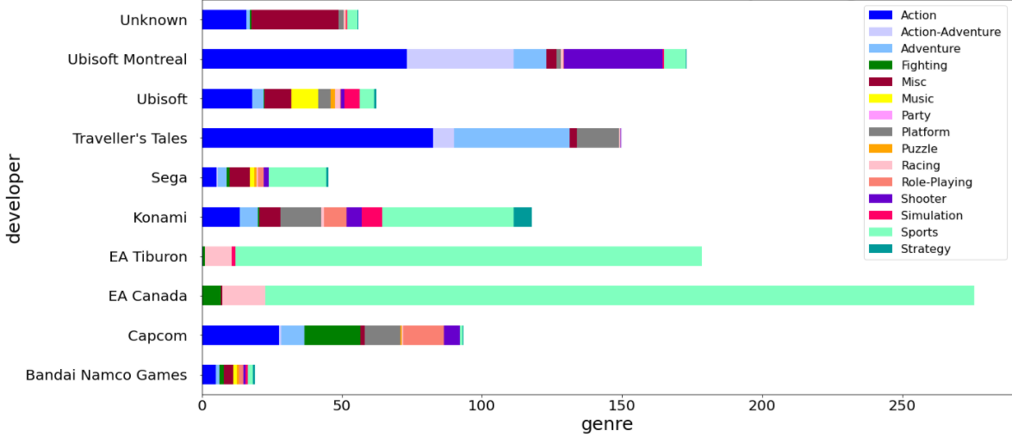
Developers

Slide 32
Machine Learning
Notes:
Illustration: Freepik

Slide 33

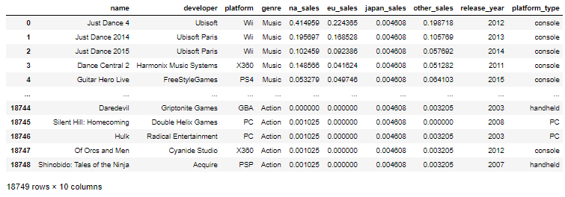
Machine Learning
So according to our prediction question “Can we predict the success of a particular game in different areas according to its sales ratio?” we decided that it’s a classification problem.
First we had to normalize the sales in the dataset because EU,NA,JAPAN didn’t have the same size area.

Slide 34

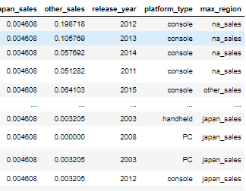
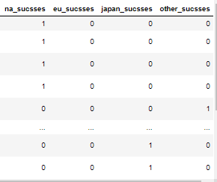
Machine Learning
Then we checked in each game which area has the largest amount of sales in relation to the other areas and put in his column the value 1 or else the valsue 0.

Slide 35

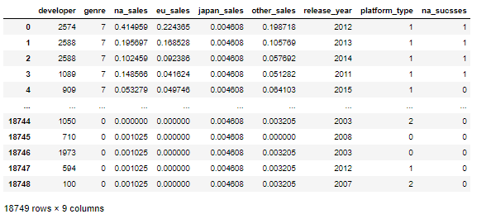
Classification models
We used 3 classification models: logistic regression, KNN and decision tree.
We transfer the dataset to numeric and then run the models and tried to predicter the na_sucsses

Slide 36



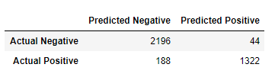


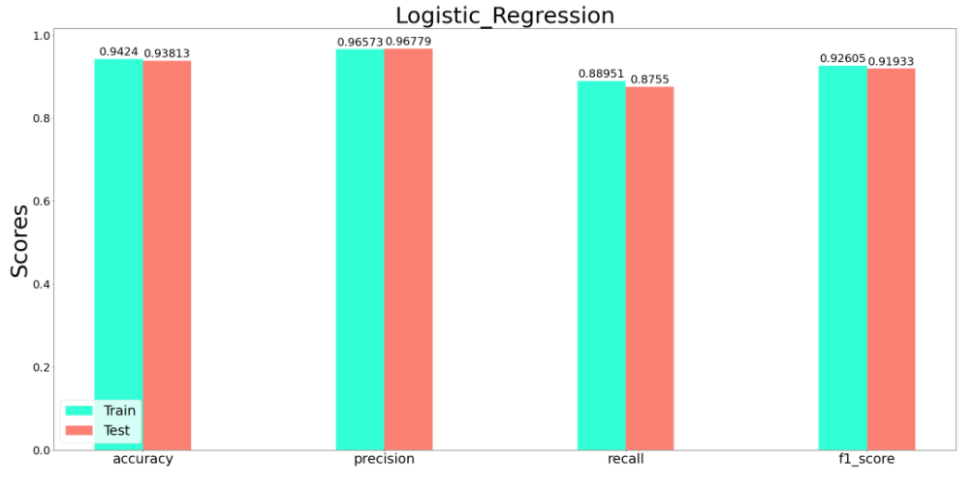
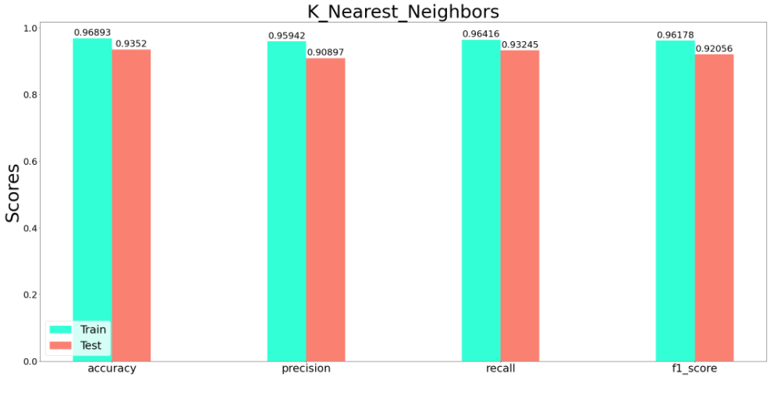
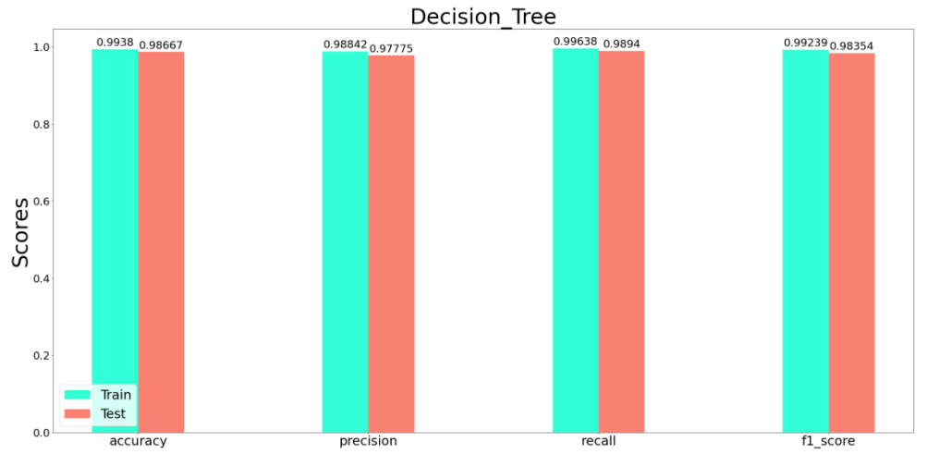
Classification models
Logistic regression:
KNN:
Decision tree:
LR_y_pred_train
knn_y_pred_train
DT_y_pred_train
LR_y_pred_test
knn_y_pred_test
DT_y_pred_test

Slide 37
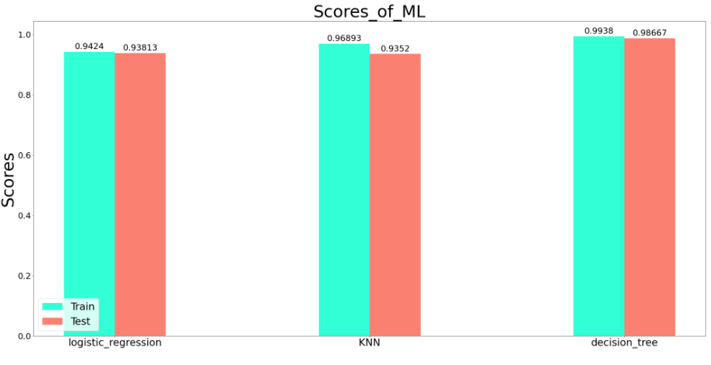
Classification models
We can see that the best model to use is decision tree, so we will continue with it to predict the rest of the areas success.

Slide 38
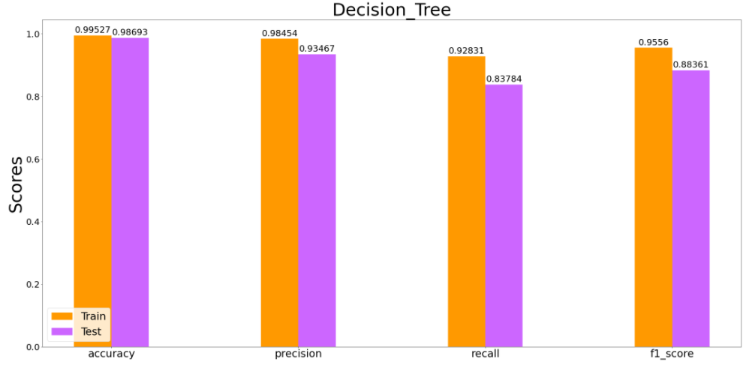
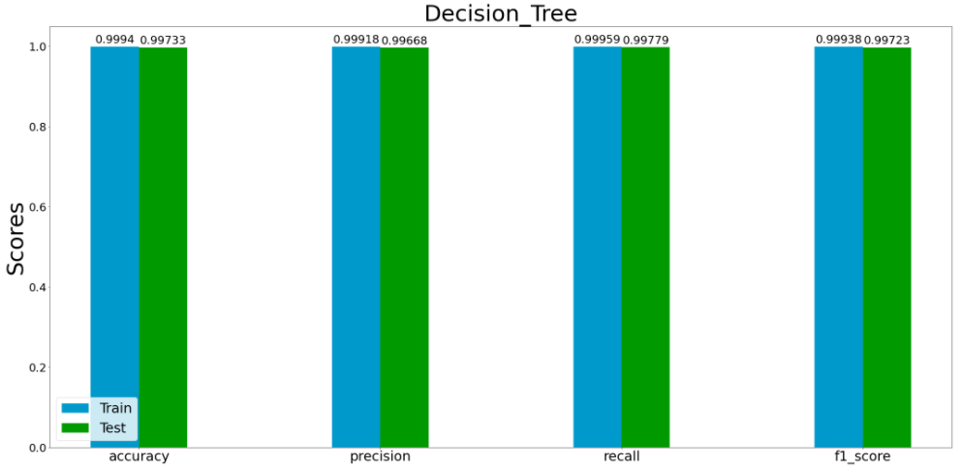
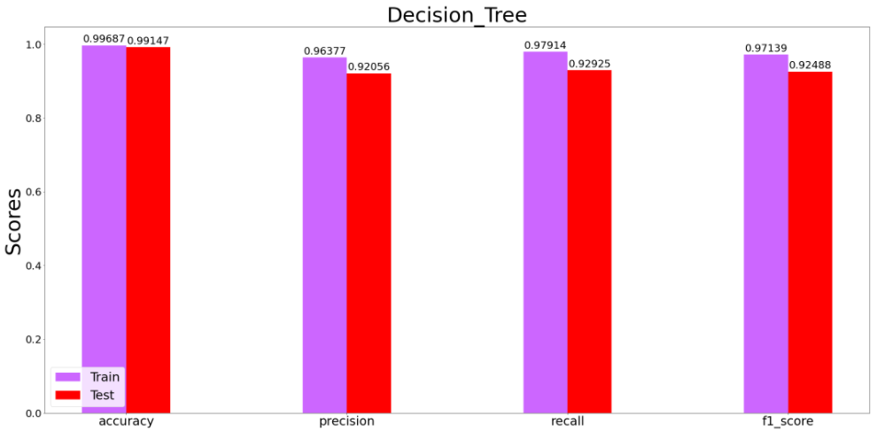
Decision tree model
eu_sucsses:
jp_sucsses:
other_sucsses:

Slide 39
Conclusions

Slide 40
The video game market has remained quite consistent and stable over the past few years.
Console is the best-selling platform type
Brand value of the Publisher has no effect on sales of videogames.
Shooter, Sports and action genre were most successful for videogames.
Sport being the most successful.
North America and Europe were the biggest markets of videogames in the world. North America being the biggest of all.
PS2 is the most successful platform for video games
Both local and global Sales of videogames is highly related to the genre and platform of the videogame.
Conclusions
Notes:
Illustration: Freepik

Slide 41
GitHub
Notes:
Illustration: Freepik

